Slide 1
Bayesian Treatment of Sensory Tuning Curves
Zongting Wu, Stephen D. Van Hooser
Notes:
Hello everyone, I am delighted to be here to share my research with you. . I am from the Van Hoose Lab, and today, I will be presenting on the topic of 'Bayesian Treatment of Sensory Tuning Curves. Today’s topic specifically in how we analyze data from the visual cortex. Our focus will be on Bayesian estimation, a robust method that significantly enhances our ability to understand neural responses, especially compared to traditional least squares fitting method.

Slide 2
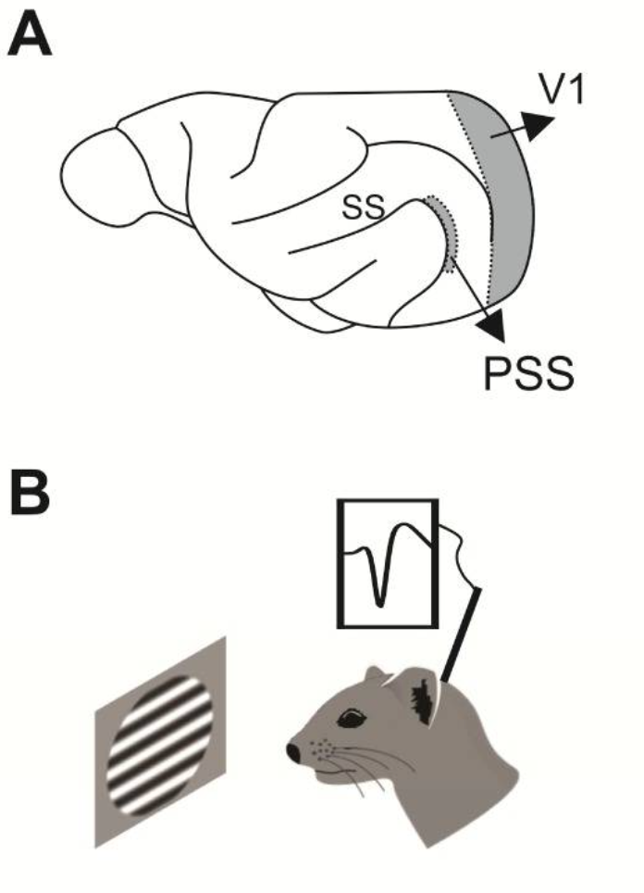
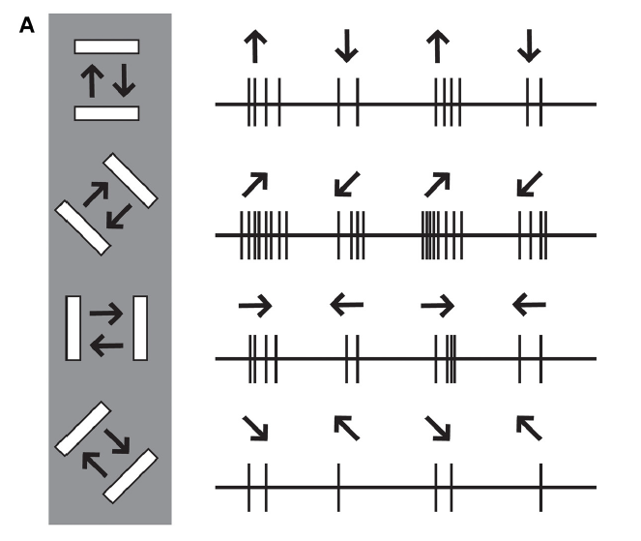
Visual Cortex & Visual Tuning
Lempel, Augusto A, and Kristina J Nielsen. “Ferrets as a Model for Higher-Level Visual Motion Processing.” Current biology : CB vol. 29,2 (2019)
Mark Mazurek, Marisa Kager, and Stephen D.Van Hooser. Robust quantification of orientation selectivity and direction selectivity. Frontiers in Neural Circuits,8, 2014.
Notes:
At the very beginning, I want to introduce the intricate process of visual tuning in the visual cortex and how we quantify it. So, the primary visual cortex, also known as V1, is the first cortical area of the brain where visual signals are processed. It is situated on the medial surface of the occipital lobe at the back of the brain. This region processes visual information, such as light, color, and shape, and is critical for tasks like motion detection and object recognition. Understanding this process is crucial as it forms the basis for more complex visual perceptions and behaviors.
We will go deep into a specific function of the visual cortex: its selectivity for the direction of motion. The image on the bottom left shows a ferret watching a black bar moving in a certain direction. Its visual cortex generates spike signals in response to the motion of the stimulus. The image on the right displays the spike signals produced by a neuron with strong directional selectivity when exposed to different directions of motion. We can observe that the frequency of the signals varies with the different direction. Usually, there is a particular direction in orientation space or direction space that elicits the strongest response frequency. After collecting signals from several directions, we can determine the tuning curve of this neuron.

Slide 3
Quantifying Visual Tuning Curve
Notes:
Quantifying visual tuning involves measuring how neurons in the visual cortex respond to specific visual stimuli. However, how do we quantitatively analyze the signals we've collected?

Slide 4
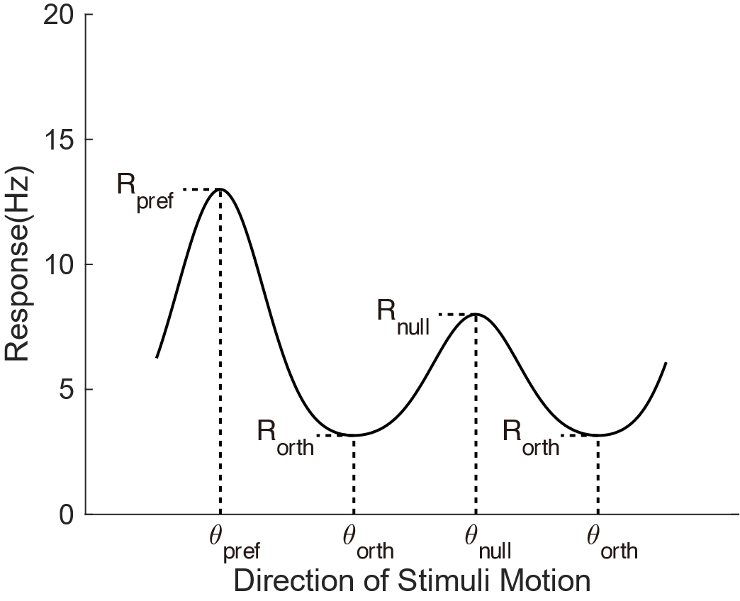
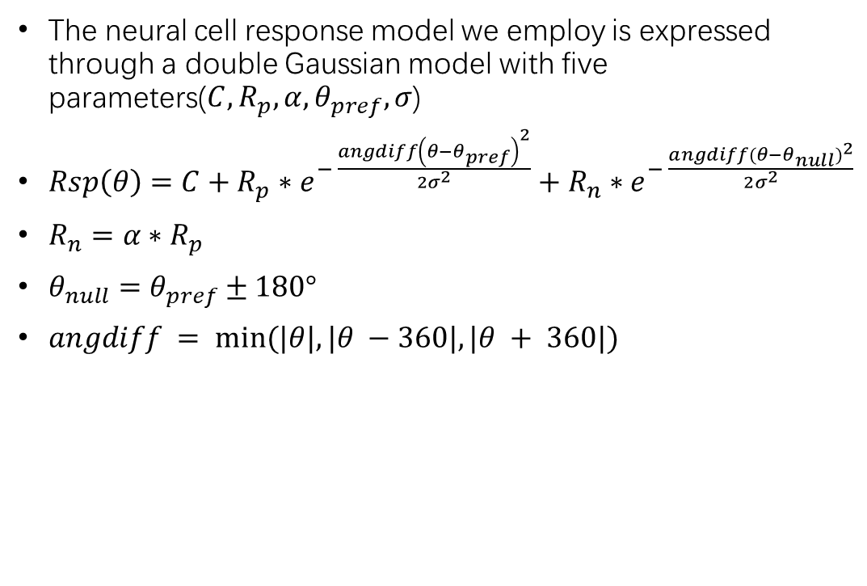
Primary Visual Cortex (V1) Signal Model
The neural cell response model we employ is expressed through a double Gaussian model with five parameters($C,R_{p},α,θ_{pref},σ$)
$Rsp\left(θ\right)=C+R_{p}∗e^{− \frac{angdiff{\left(θ−θ_{pref}\right)}^{2}}{2σ^{2}}}+R_{n}∗e^{− \frac{angdiff{(θ−θ_{null})}^{2}}{2σ^{2}}}$
$R_{n}=α∗R_{p}$
$θ_{null}=θ_{pref}±180°$
$angdiff = min⁡(|θ|, |θ −360|, |θ + 360|)$
Notes:
First of all, we need a model for the neuron's tuning curve. Based on previous studies, we use a double Gaussian model to fit the sampled points. The mathematical equation for the double Gaussian model is shown above, and it includes five parameters.
Our goal is to find the most suitable values within the five-dimensional parameter space. Traditionally, this has been achieved through methods like least-squares fitting or bootstrap fitting. However, a more accurate representation can be achieved through statistical methods that account for the inherent uncertainties in both the data and the model.
%%It's important to note that the values in the tuning curve shown in the left image are calculated based on the parameter combination at a certain angle, not the value of a specific parameter. For instance, the magnitude of preferred Response equal to the response equation at theta pref.
$\%\% σ$ is the standard deviation of Gaussian distribution. In general, offset,which is $C$, means the value of static frequency and background noise due to laboratory equipment and measurement. $R_{pref}$ is the magnitude above the preferred direction offset and $R_{null}$ is the magnitude above the null direction (opposite-preferred direction)

Slide 5
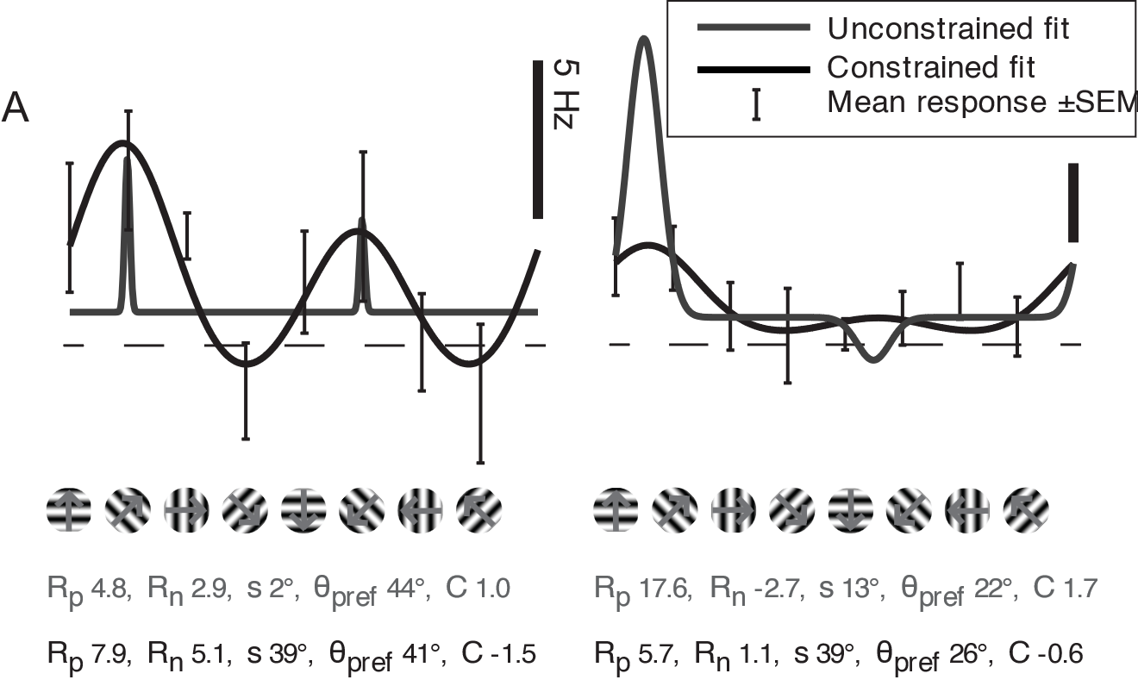
Least-Square Fitting
Advantages:
Flexibility
Interpretability
Accuracy
Disadvantages:
Sensitivity to Outliers
Overfitting
Ignoring Uncertainty
etc
Mark Mazurek, Marisa Kager, and Stephen D.Van Hooser. Robust quantification of orientation selectivity and direction selectivity. Frontiers in Neural Circuits,8, 2014.
Notes:
Before we introduce Bayesian estimation, we must mention least-squares fitting. This method is simple, fast, and effective, capable of providing relatively robust results for various types of functions. This demonstrates its flexibility, interpretability, and accuracy. Traditionally, we've relied on least squares fitting to model these neural responses. However, this method assumes that all errors are normally distributed and is highly sensitive to outliers. It often fails to capture the complex, nonlinear behaviors of biological systems, particularly when we encounter flat or weakly responsive tuning curves.
Let’s consider some examples where least-squares fitting might lead us astray. In the image on the right, you can see several results of least squares fitting, including unconstrained and constrained fits. The results show that without constraints, it is very easy to achieve overly narrow and high peaks, which is a case of overfitting, with the sigma fitting result being too small. There can even be negative Response null values. Although applying constraints to each parameter makes the fit results appear more reasonable, this method still only yields a single fit result without a probability distribution. It cannot address the probability distribution issues inherent in complex neural systems.

Slide 6
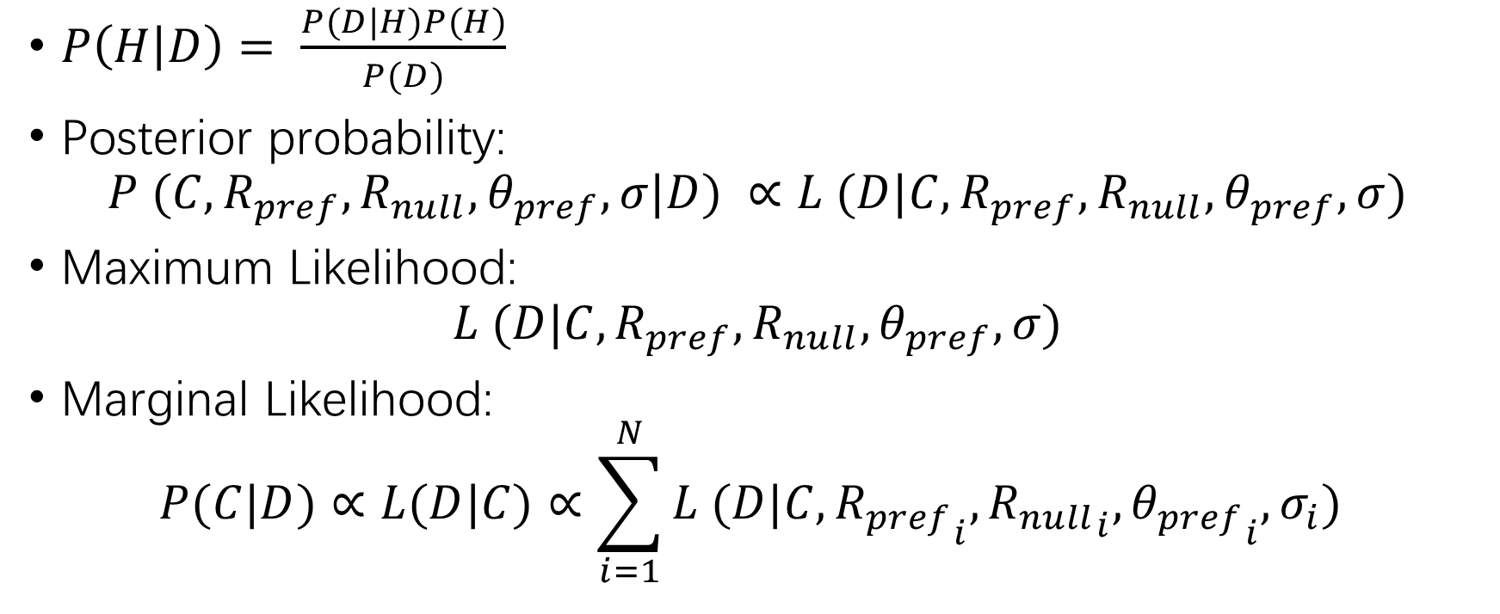
Bayes Estimation
$P\left(H | D\right)= \frac{P(D|H)P(H)}{P(D)}$
Posterior probability:
$$P (C,R_{pref},R_{null},θ_{pref},σ|D) ∝L (D|C,R_{pref},R_{null},θ_{pref},σ)$$
Maximum Likelihood:
$$L (D|C,R_{pref},R_{null},θ_{pref},σ)$$
Marginal Likelihood:
$$P(C|D)∝L(D|C)∝\sum_{i=1}^{N}{L (D|C,{R_{pref}}_{i},{R_{null}}_{i},{θ_{pref}}_{i},σ_{i}) }$$
Notes:
Now let’s moving to a more robust approach, which is Bayesian estimation. It’s a statistical method used to estimate unknown parameters of a probability distribution, which differs from least square fitting in its treatment of unknown parameters. Unlike least-squares fitting, Bayesian methods incorporate prior knowledge and update this as more data becomes available, offering a dynamic and iterative way to refine our estimates. This method naturally integrates uncertainty and variability, providing more reliable and interpretable results.
In our fitting process, H represents the hypothesized model response theta, which is modeled by the double Gaussian equation mentioned in previous slide. D represents the numerical values of response frequencies from either simulated or real data. During the actual fitting process, because we assume that the prior probability distribution is unknown, we treat the prior probability as uniform. Additionally, since we are not expanding or changing the dataset in our analysis, what we compute are the marginal likelihood and the maximum likelihood. This means that in our formular, the probability of the hypothesis and the evidence are constants.

Slide 7

Descriptors
Orientation Index
$$OI = (R_{pref} + R_{null} − (R_{orth+}+R_{orth−}))/(R_{pref} + R_{null})$$
Direction Index
$$DI = (R_{pref}−R_{null})/R_{pref}$$
Notes:
At the same time, we have introduced two descriptors to quantify spatial selectivity, aiming to better visualize the spatial selectivity of different neurons. In short words, the larger the values of the descriptors, the stronger the directional selectivity.

Slide 8
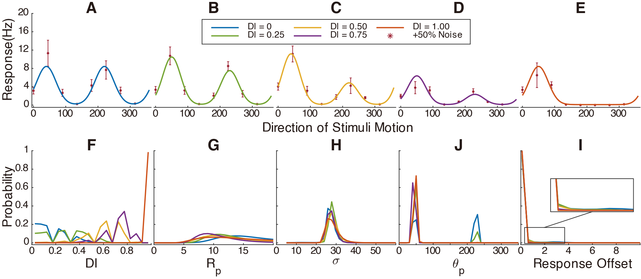
Advantages of Bayesian Estimation
Notes:
The advantages of Bayesian estimation are numerous. It allows for a more nuanced model of neural responses, accounts for prior beliefs about the data, and adjusts those beliefs in the light of new evidence. This results in a more flexible and comprehensive understanding of neural tuning.
To test the performance of the Bayesian estimation model, we simulated two groups of data with different values for the direction index and orientation index for fitting. First, we simulated five neurons with different direction index, and the five figures above represent the simulated datasets and the fitting results of Bayesian estimation. Each color corresponds to the fitting results of one simulated dataset. The legend shows the simulated true values of the descriptor. As can be seen, the fitting results accurately match the theoretical values, and this is also reflected in the probability distributions of different parameters or descriptors.
For example, the blue line represents the simulated dataset with a direction index equal to 0, while the red one represents a direction index equal to 1. Although the fitting curves appear jagged due to the spacing of the fitting interval, it can still be observed that in Figure F, the blue probability reaches its maximum near 0. Clearly, the red line predicts the result of a direction index equal to 1. Meanwhile, because the blue and green have close values for response pref and response null, it can be seen in Figure J that Bayesian estimation gives a smaller probability peak at theta null.

Slide 9
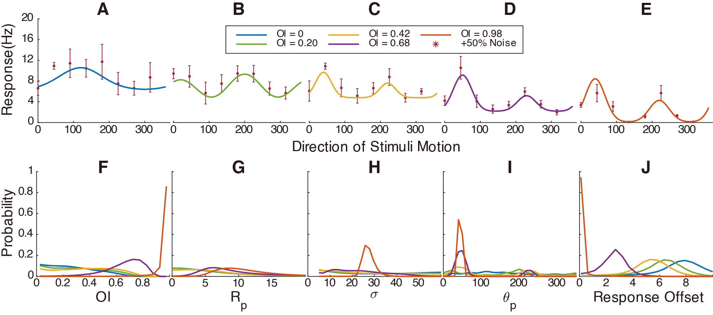
Advantages of Bayesian Estimation
Notes:
Similarly, we have different values for orientation index. Unlike the previous cases, the data have a higher response offset, making the peaks more difficult to accurately fit, especially in cases of very weak directional selectivity. In cases of weak signals, such as the blue one in Figure A, Bayesian methods typically show increased uncertainty in estimates, which is reflected in flatter probability distributions. This represents the underlying data variability.
Despite the probability distributions becoming flatter, the peaks of these distributions can still accurately fit the true simulated values.

Slide 10
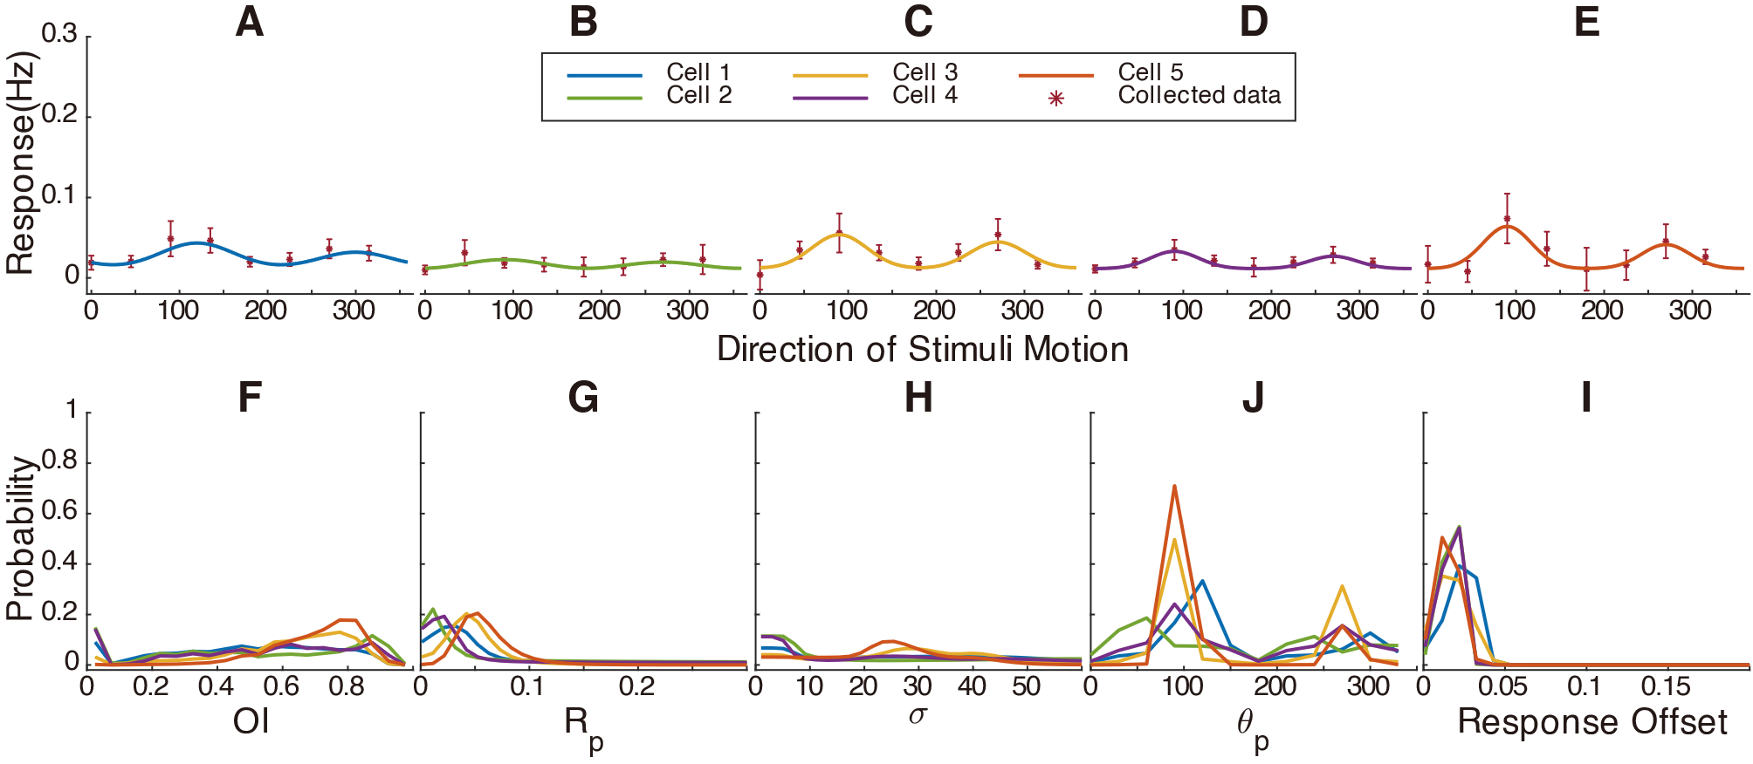
Testing the Bayesian Model with Real Data
Notes:
Now, let’s apply the Bayesian estimation method to real collected data from the visual cortex. In actual measurement processes, the type of data obtained depends on the experimental techniques used. The data for this study were obtained using fluorescence methods to measure the tuning curves. This also demonstrates that our model is not limited by the experimental method employed.
Oh, please note that there is a correction on the left of Figure A: the real data were obtained by fluorescence methods to measure the tuning curve, and the units are not Hz, but this does not affect the model's fitting results. Compared to simulated data, the real data are flatter. However, you can still see in Figure H that the fitting results for the tuning width of the yellow and red are around the value of 25, which is due to the higher peaks in Figure C and E.
These data are already selected from neurons with relatively obvious selectivity. In Figure F, despite the probability distributions for blue, green, and purple being very flat and having higher probabilities near a value of 0, the probabilities gradually increase as the Orientation Index value increases, peaking at about 0.9. These fitting results robustly provide the probabilities of the fit and potential probabilities, such as the low orientational selectivity probabilities seen in Figure F.

Slide 11
Conclusion
Robust and Versatile Fitting
Bayesian estimation can effectively replace least squares fitting, providing robust results across a wide range of tuning curves. It excels not only in scenarios with clear directional selectivity but also delivers accurate parameter combinations for flatter tuning curves where traditional methods struggle
Probabilistic Insights into Fit Results
Unlike the single-point estimates produced by least squares methods, Bayesian estimation provides a visualizable probability distribution of fitting results. This probabilistic approach offers a higher degree of credibility, as it transparently represents the uncertainty and variability inherent in the data
Notes:
In conclusion
Firstly, Bayesian estimation can effectively replace least squares fitting, providing robust results across a wide range of tuning curves. It excels not only in scenarios with clear directional selectivity but also delivers accurate parameter combinations for flatter tuning curves where traditional methods struggle.
Secondly, unlike the single-point estimates produced by least squares methods, Bayesian estimation provides a visualizable probability distribution of fitting results. This probabilistic approach offers a higher degree of credibility, as it transparently represents the uncertainty and variability inherent in the data.

Slide 12
Thanks
Notes:
That’s what I have to share with you today. I would like to extend my sincere thanks to Steve for his valuable guidance throughout the project. Thank you all for your attention.

Slide 13
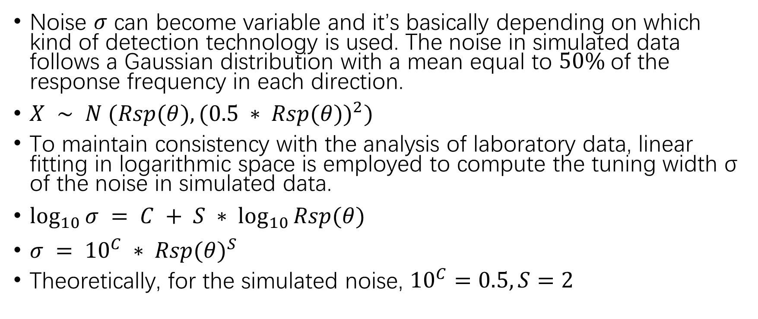
Noise Model
Noise $σ$ can become variable and it’s basically depending on which kind of detection technology is used. The noise in simulated data follows a Gaussian distribution with a mean equal to $50\%$of the response frequency in each direction.
$X ∼ N (Rsp(θ), {(0.5 ∗ Rsp(θ))}^{2})$
To maintain consistency with the analysis of laboratory data, linear fitting in logarithmic space is employed to compute the tuning width σ of the noise in simulated data.
$\log_{10}{σ} = C + S ∗ \log_{10}{Rsp(θ)}$
$σ = {10}^{C} ∗ {Rsp(θ)}^{S}$
Theoretically, for the simulated noise, ${10}^{C}=0.5,S=2$

